Slide 1

Predictive modelling of Global Region based on Micronutrient Deficiency using Supervised Machine Learning Algorithms
AI and Machine Learning Project
Panu Khumchoo-Joonpijarn
23135551

Slide 2
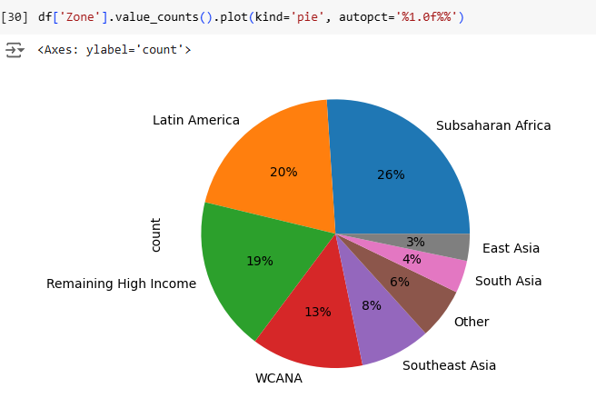
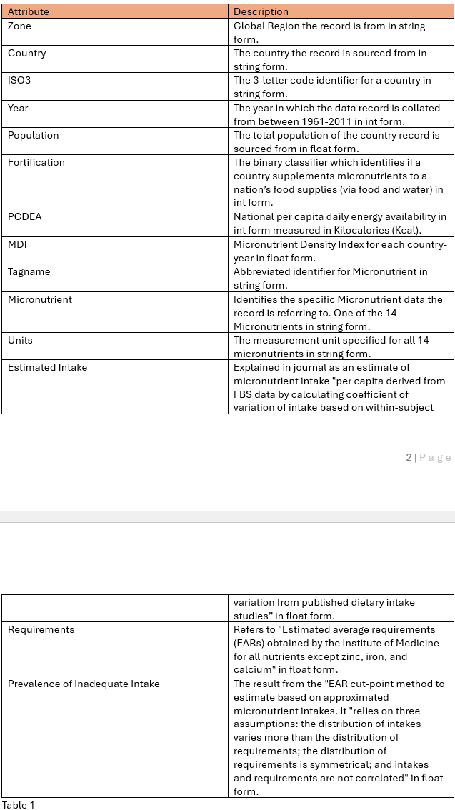
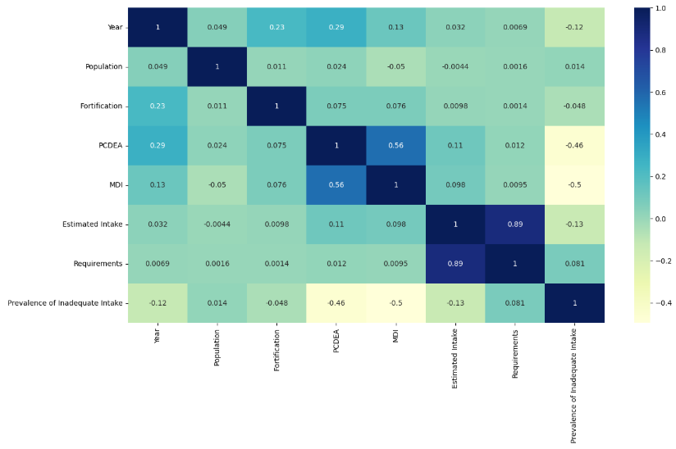
Dataset Analysis

Slide 4
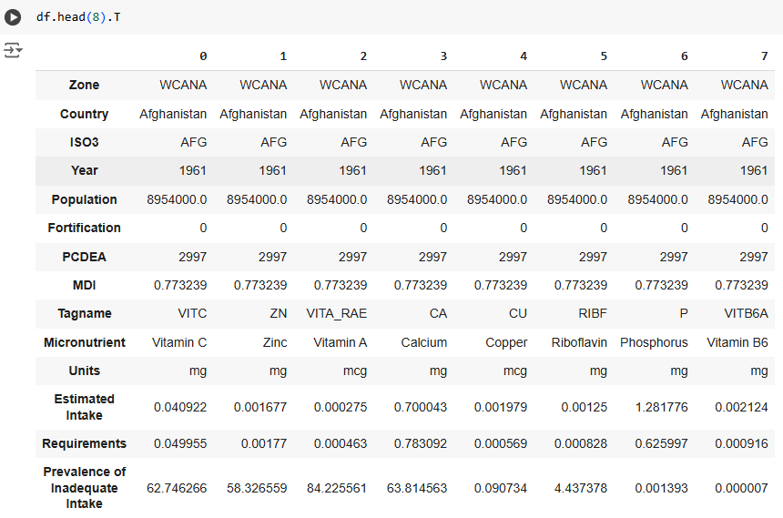
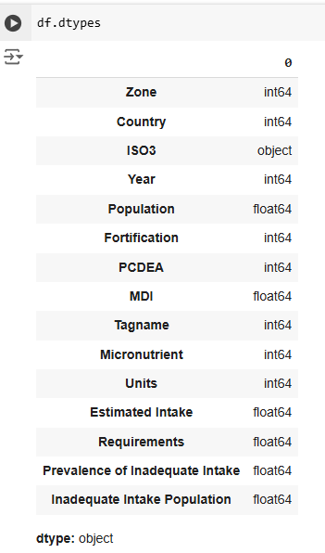
Pre-Processing
Data before
Data after

Slide 5
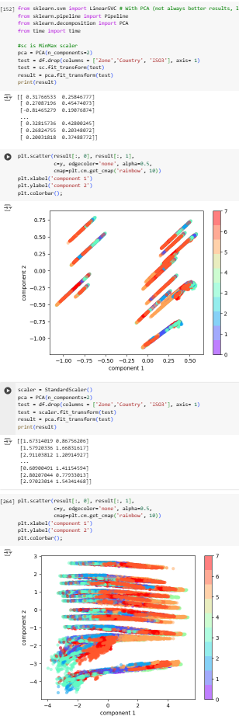
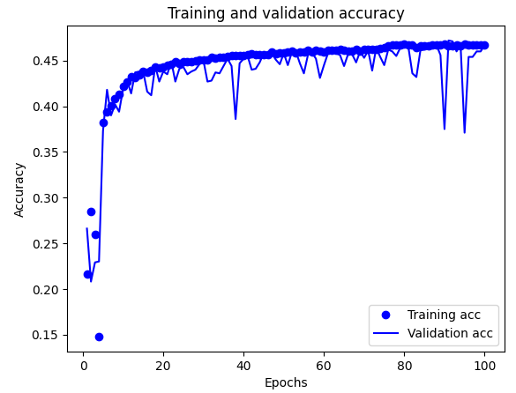
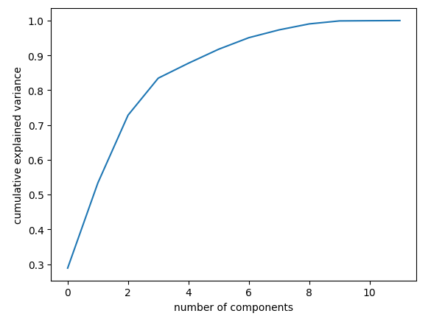
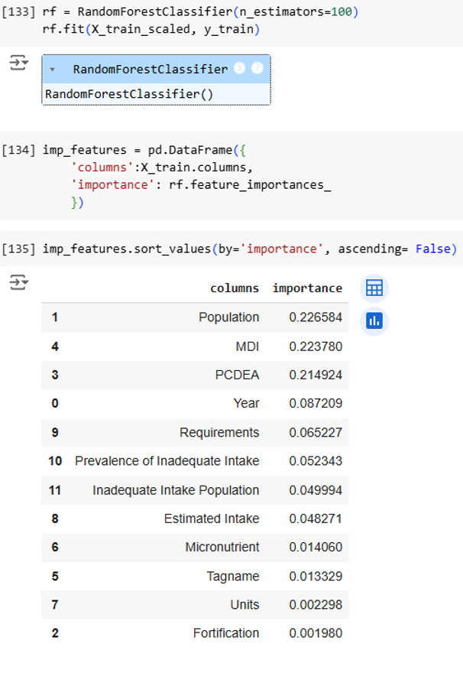
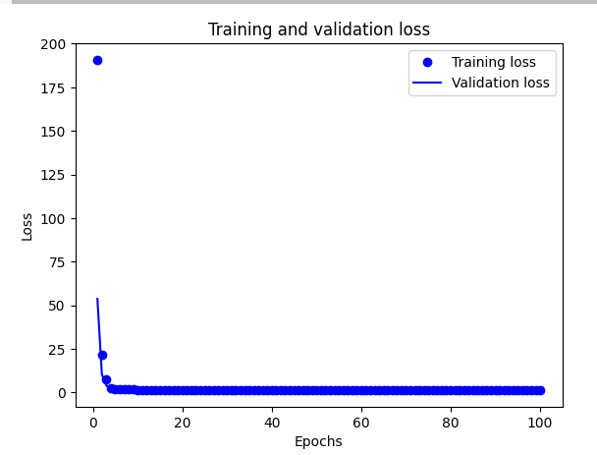
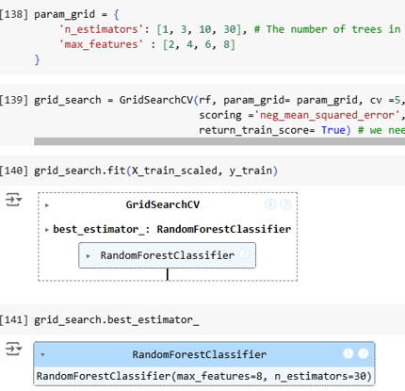
Hyperparameter Testing and PCA
Min-max Scaler
Random Forests
Importance Values RF
Hyperparameter GridSearch for RF
Deep Learning
Standard Scaler
Random Forests

Slide 6
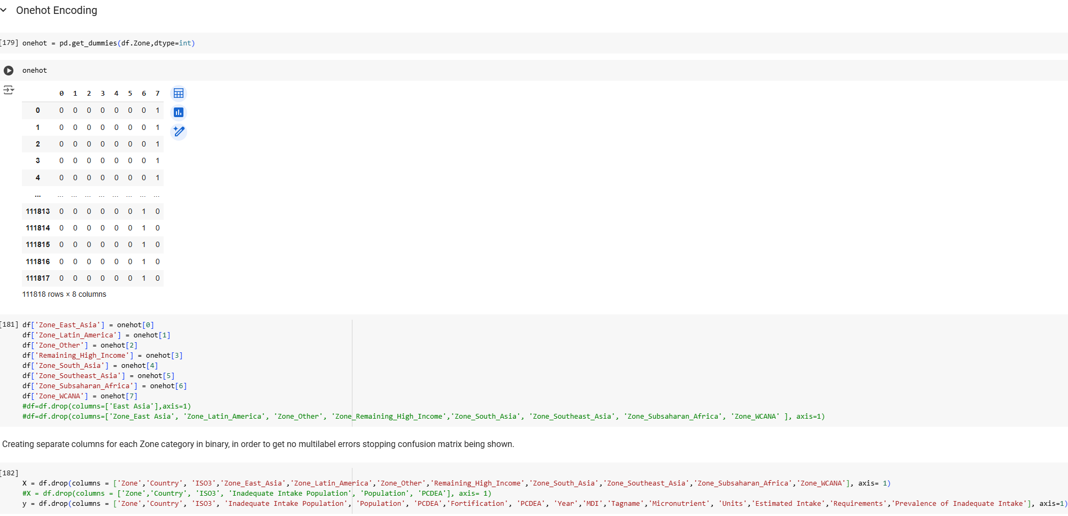
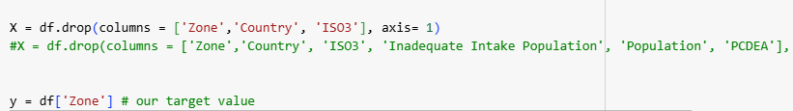
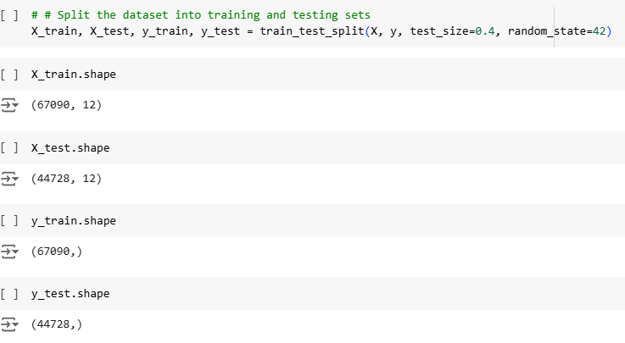
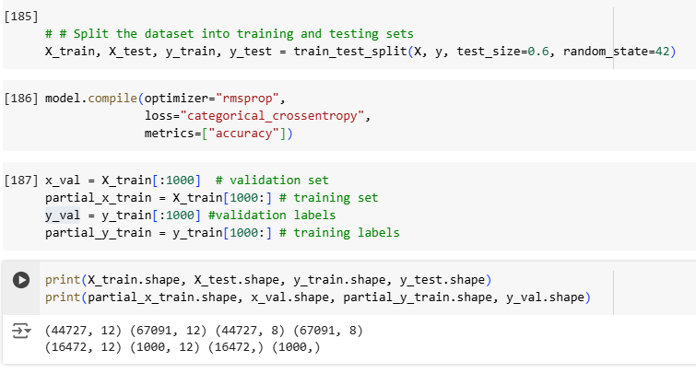
Train-Test Split
RF, KNN, Decision-Tree
Deep Learning

Slide 7
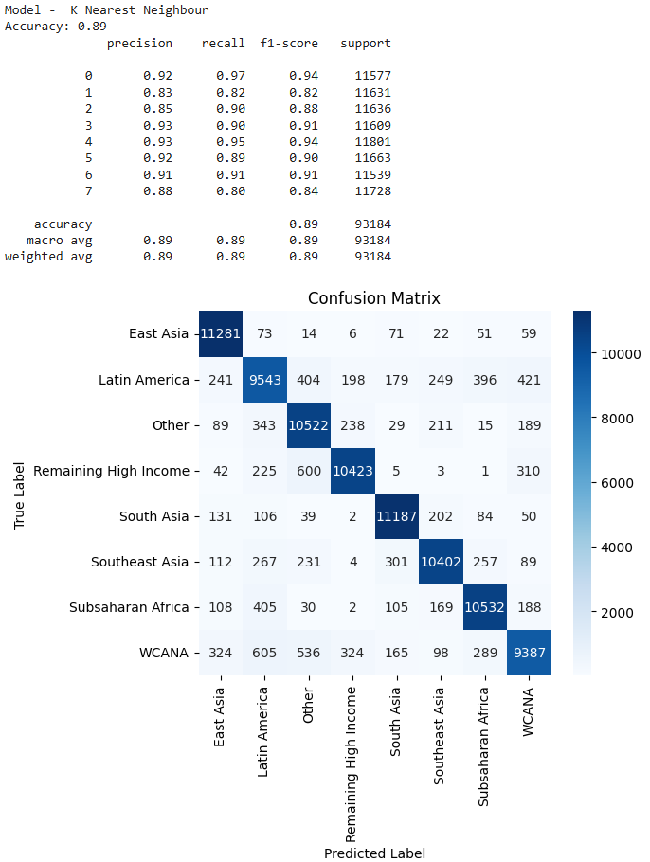
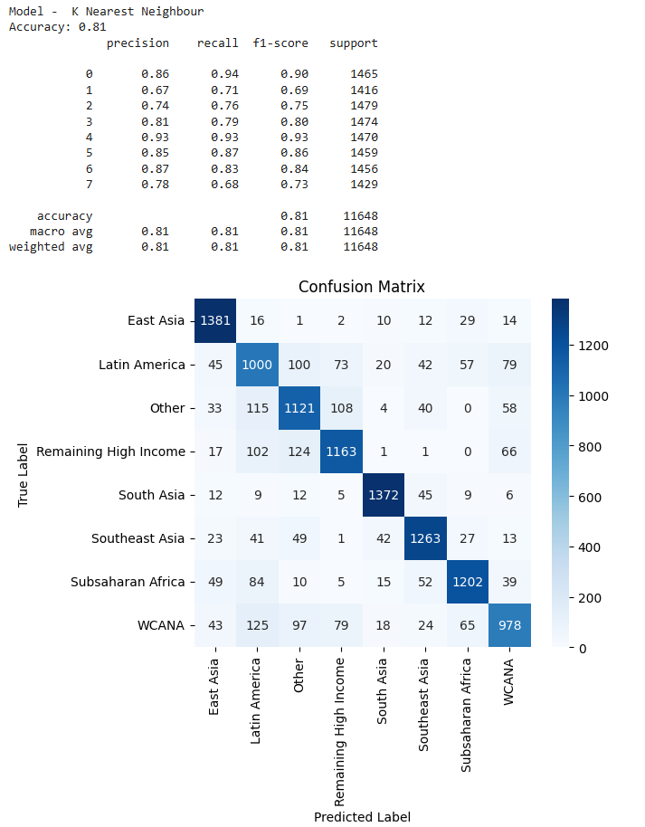
Results
KNN w/SMOTE
KNN w/NearMiss
Model | Accuracy/Macro Avg/Weighted Avg
Decision Tree Classifier (SMOTE w/hyperparams) | 0.97/0.97/0.97
Decision Tree Classifier (NearMiss w/hyperparams) | 0.98/0.98/0.98
Random Forests Classifier (SMOTE) | 0.89/0.89/0.89
Random Forests Classifier (NearMiss) | 0.98/0.98/0.98

Slide 8
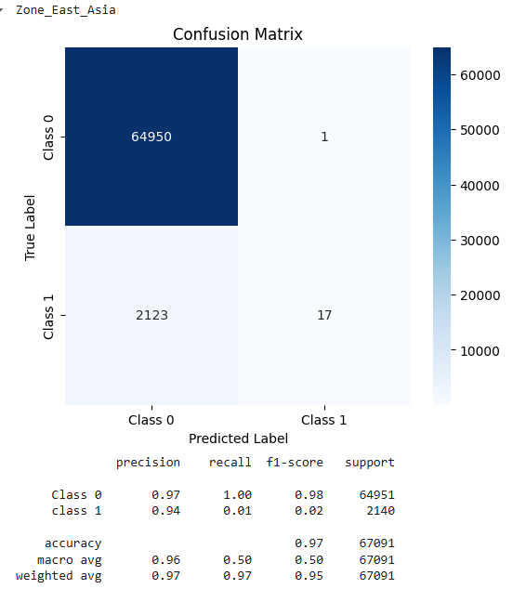
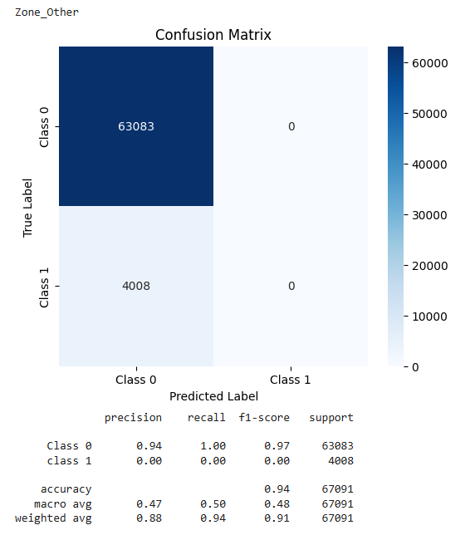
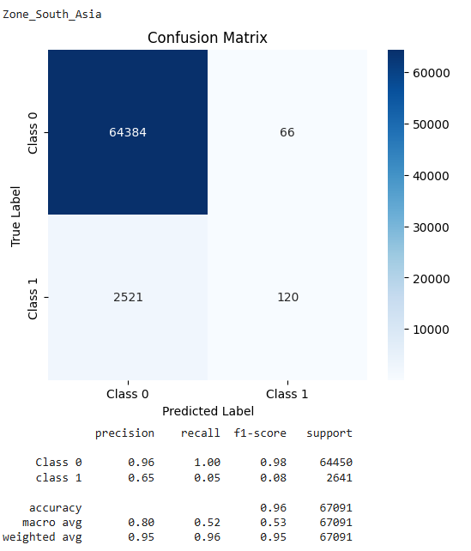
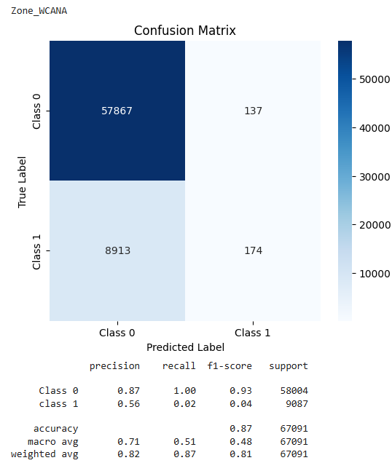
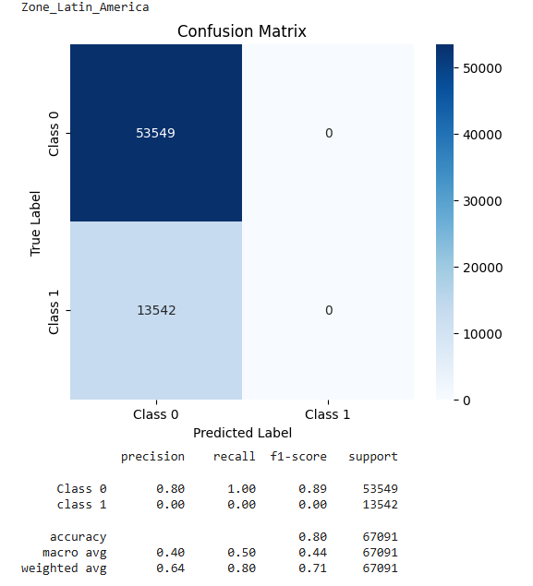
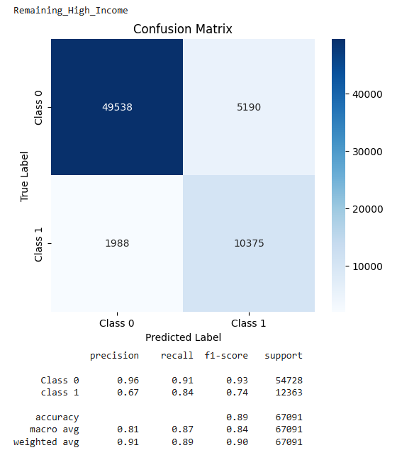
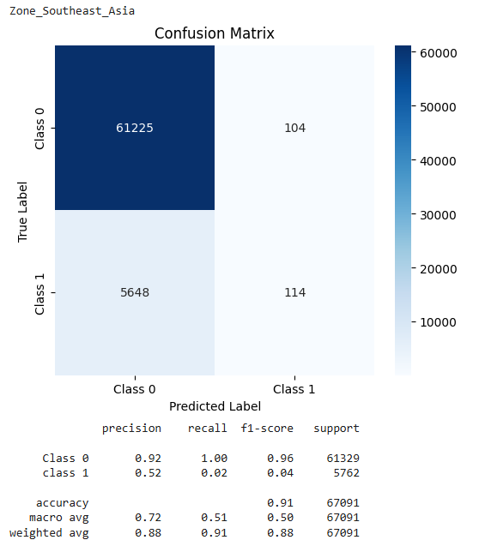
Deep Learning Result

Slide 9
Predictive modelling of Global Region based on Micronutrient Deficiency using Supervised Machine Learning Algorithms
Conclusion
Unsure if deep learning predicting multiple zones for 1 record
Random forest best performance and speed trade off
All Tree based models worked better than non-tree/majority vote
Must be tested further as data-leakage compromises model ability to be generalised purpose

